Slide 1

PRACTICAL SUBMISSION SQL IN DATA SCIENCE
Presented To-Nitish Patil
Presented By-Anamika Gupta
School of Data Science 2024 | AAFT

Slide 3
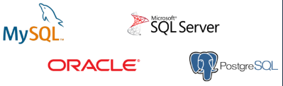
Database
Database is collection of data in a format that can be easily accessed (Digital)
Types of Databases
Relational Non-relational (NoSQL)
Data stored in tables data not stored in tables
** We use SQL to work with relational DBMS

Slide 4
What is SQL?
Structured Query Language
SQL is a programming language used to interact with relational databases.
Structured Query Language
It is used to perform CRUD operations :
Create
Read
Update
Delete

Slide 5
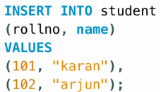
Table related Queries
Insert
INSERT INTO table_name
(colname1, colname2);
VALUES
(col1_v1, col2_v1),
(col1_v2, col2_v2);

Slide 6
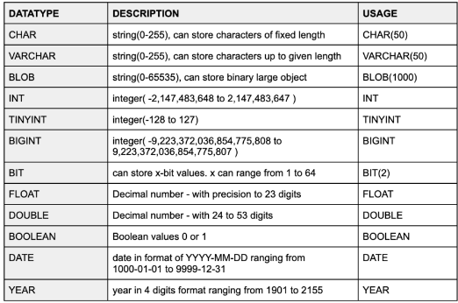
Types of SQL Commands
DDL (Data Definition Language) : create, alter, rename, truncate & drop
DML (Data Manipulation Language) : select, insert, update & delete
DCL (Data Control Language) : grant & revoke permission to users
DQL (Data Query Language) : select
TCL (Transaction Control Language) : start transaction, commit, rollback etc.
SQL Datatypes
They define the type of values that can be stored in a column

Slide 7
This query uses:
Group Functions:
SELECT product_name, SUM(quantity) AS total_sold FROM orders GROUP BY product_name HAVING SUM(quantity) > ( SELECT AVG(quantity) FROM orders -- Subquery to calculate average quantity );
This query uses:
Group Functions (SUM): To calculate the total quantity sold for each product.
Group By: To group data by product name.
Having Clause: To filter products with total sales exceeding the average quantity (obtained using a subquery that calculates the average quantity).
Subquery (AVG): To calculate the average quantity of all orders.
By combining these elements, the query retrieves products exceeding the average sales volume.
Group functions perform aggregate calculations on sets of data grouped by a specific column or set of columns. Common examples include:
COUNT: Counts the number of rows in a group.
SUM: Calculates the sum of a numeric column within a group.
AVG: Calculates the average of a numeric column within a group.
MIN/MAX: Returns the minimum or maximum value of a column within a group.
By grouping data, you can summarize and analyze trends across different categories.

Slide 8
Subqueries
String Functions:
Subqueries are essentially nested queries embedded within another query. They allow you to retrieve data that will be used as part of the main query's logic. Common uses include:
Filtering data: Use a subquery to filter the main query based on specific conditions.
Joining tables: Subqueries can be used for complex joins with multiple tables.
Aggregating data: Perform calculations within a subquery and use the result in the main query.
Subqueries offer flexibility and power in retrieving and manipulating data based on complex criteria.
String functions operate on text data, manipulating characters or extracting information from strings. Common examples include:
CONCAT: Concatenates (joins) multiple strings into a single string.
UPPER/LOWER: Converts a string to uppercase or lowercase, respectively.
LENGTH/SUBSTRING: Returns the length of a string or extracts a substring based on position or delimiters.
TRIM/REPLACE: Removes leading/trailing spaces (TRIM) or replaces specific characters/substrings (REPLACE).
INSTR/LIKE: Finds the position of a substring within a string (INSTR) or performs pattern matching (LIKE).

Slide 9
Joins:
Joins are used in SQL to combine data from multiple tables based on a shared relationship between them. There are different types of joins depending on how you want to handle rows that don't have matching values in the other table.
Inner Join: This is the most common join. It returns only rows where there's a match in both tables based on the join condition.
Left Join: Returns all rows from the left table (the one mentioned first in the query) and matching rows from the right table. If there's no match in the right table, null values are returned for the right table's columns.
Right Join: Similar to left join, but returns all rows from the right table and matching rows from the left table. Null values are filled for unmatched rows in the left table.
Full Join: Combines all rows from both tables, regardless of whether there's a match. Null values are filled for unmatched columns in either table.

Slide 10
Set Operators - UNION, UNION ALL & INTERSECT:
Creating Views & Types of Views:
These operators work on the result sets of two or more SELECT statements, combining or filtering rows based on set theory principles.
A view is a virtual table that acts like a stored query. It doesn't store data itself, but retrieves data based on the underlying query definition. Here are some types of views:
UNION: Returns the distinct (unique) rows from the combined results of two or more SELECT statements. Duplicate rows are eliminated.
UNION ALL: Returns all rows from the combined results of two or more SELECT statements, including duplicates.
INTERSECT: Returns only the rows that are present in both result sets being compared.
Simple View: Created from a single SELECT statement, often used to simplify complex queries or present data in a specific format.
Join View: Created from a query joining multiple tables, providing a consolidated view of related data.
Aggregation View: Created from a query with aggregation functions (SUM, COUNT, AVG etc.), offering summarized data.
Updatable View: In some database systems, you can create views that allow limited updates or deletes based on the underlying table structure.

Slide 11
Top-N Analysis:
Top-N analysis involves identifying and retrieving the top (or bottom) N rows from a result set based on a specific sorting criterion. This is often achieved using the ORDER BY clause along with a limit on the number of rows returned. Here are some common approaches:
Top-Selling Products: Find the top N products based on total sales quantity or revenue.
Most Active Users: Identify the top N users based on login frequency, purchase history, or other activity metrics.
N Recent Orders: Retrieve the most recent N orders placed in a database.

Slide 12
::

Slide 13
Window Functions with OVER Clause in SQL
Window functions operate on a set of rows within a window defined by the OVER clause. They allow you to perform calculations or comparisons based on the position of a row relative to other rows in the same group.
Key Components:
Window Function: The function you want to apply within the window, such as RANK(), SUM(), AVG(), etc.
OVER Clause: Defines the window for the function. It can specify:
PARTITION BY: Divides the data into groups before applying the function.
ORDER BY: Sorts the data within each partition before applying the function.
Frame Clause (Optional): Specifies which rows are included in the window relative to the current row (e.g., preceding rows, following rows).

Slide 14
Common Window Functions:
Working with Rollups and Cubes:
Rollups and Cubes are advanced window function concepts used for multi-level aggregation and summarization of data.
RANK(): Assigns a rank to each row within a partition, with gaps between ranks if there are ties.
DENSE_RANK(): Similar to RANK() but assigns consecutive ranks without gaps, even for ties.
FIRST_VALUE(): Returns the first value (based on the order) within the window for a specified column.
LAST_VALUE(): Returns the last value within the window for a specified column.
LEAD() & LAG(): Access values from rows that follow (LEAD) or precede (LAG) the current row by a specified number of positions within the window.
Rollup: Creates a hierarchical summary table by progressively grouping levels of a dimension and aggregating data at each level.
Cube: Creates a multi-dimensional summary table where all possible combinations of dimension levels are included, allowing for analysis across different groupings.
These functionalities are typically used with specialized data warehouses or OLAP (Online Analytical Processing) tools.

Slide 15
Solution
Our product makes consumer lives easier, and no other product on the market offers the same features
Gen Z (18-25 years old)
Reduce expenses for replacement products
Simple design that gives customers the targeted information they need
Close the gap
Target audience
Cost savings
Easy to use

Slide 16
Setting Up Your Environment for Working with Databases in Python
1. Choose a Python environment manager:
Option 1: virtualenv (lightweight)
Install: pip install virtualenv
Create a virtual environment: virtualenv my_db_env
Activate: source my_db_env/bin/activate (Linux/macOS) or my_db_env\Scripts\activate.bat (Windows)
Option 2: conda (more comprehensive)
Install: Follow instructions for your operating system from.
Create a new environment: conda create -n my_db_env python=x.y (replace x.y with your desired Python version)
Activate: conda activate my_db_env
2. Install a database library:
Popular choices include:
MySQL: pip install pymysql
PostgreSQL: pip install psycopg2
SQLite (lightweight, embedded database): No additional installation needed (built-in)
3. Verify Python and library installation:
Open a Python interpreter (type python or python3 in your terminal) and try:

Slide 17
Thank you For Your Nice Attention

